Slide 1
REGRESSION
CREATED BY : SOFIAN FADLI, S.T.

Slide 2
Materi yg akan kita pelajari :
Simple Linear Regression
Multiple Linear Regression
Polynomial Regression

Slide 3
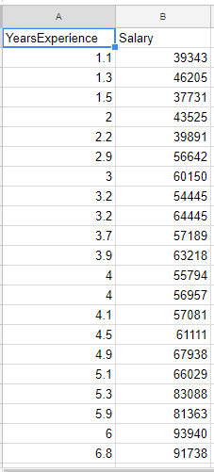

Problem 1 – Modelling Employee Sallary

Slide 4
SIMPLE LINEAR REGRESSION
Part I

Slide 6
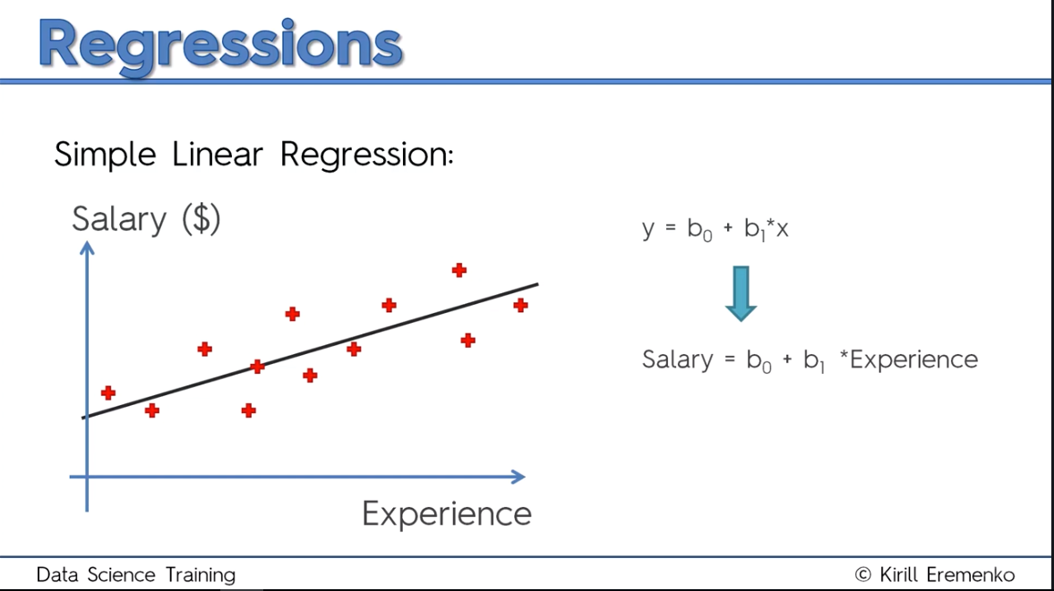
Rumus Regression

Slide 8
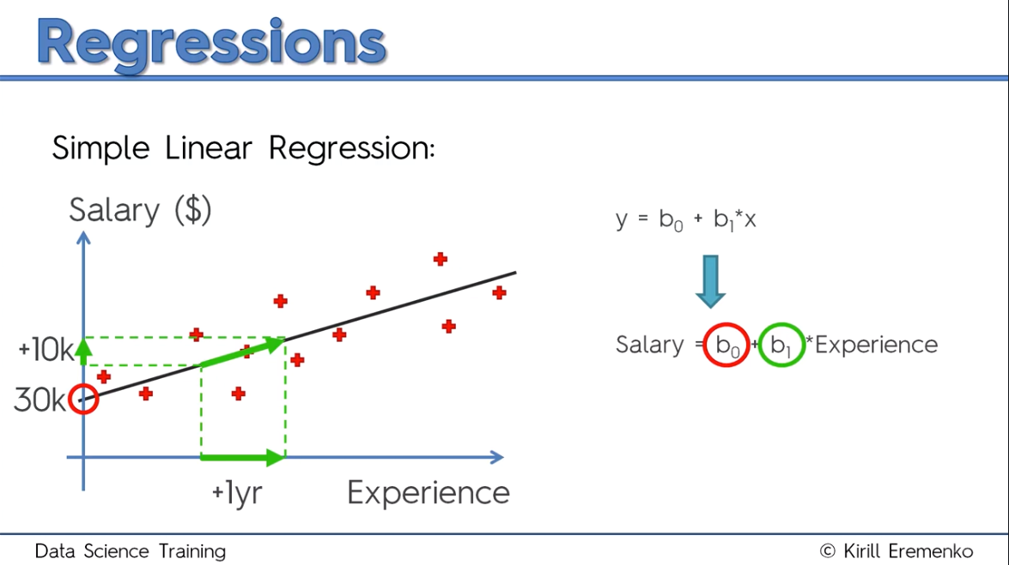
Kemiringan dari garis / gradient

Slide 9
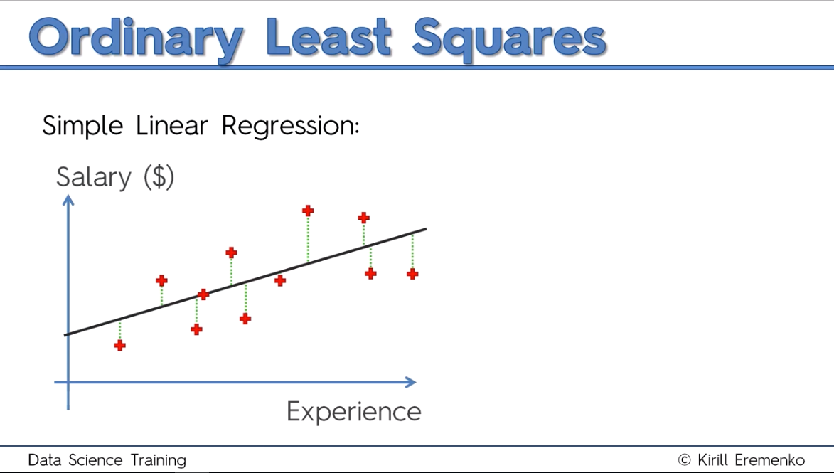

Slide 10
Actual Values
Predicted Values

Slide 12
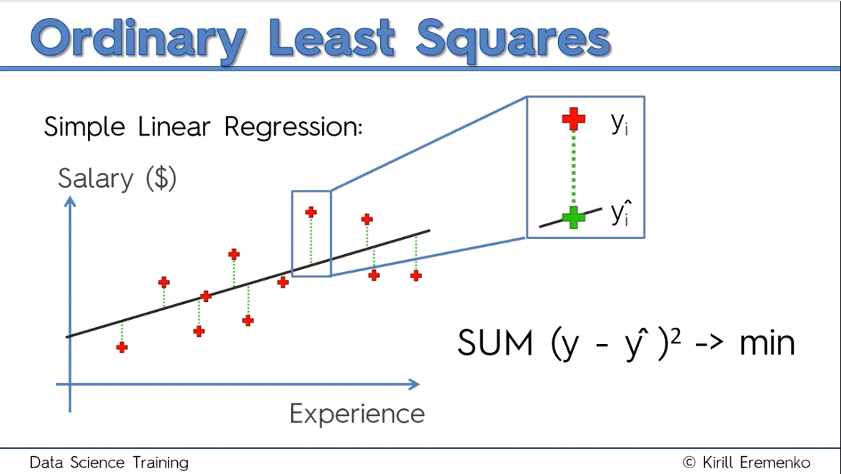

Slide 13
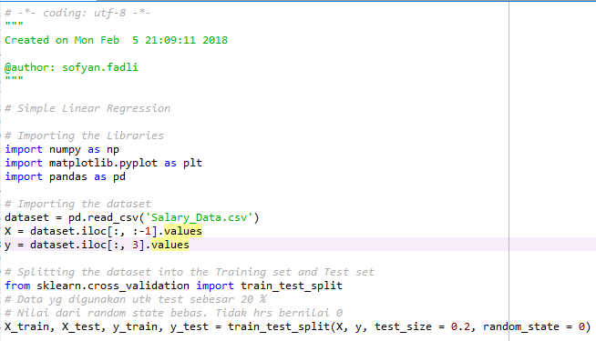
Data Preprocessing

Slide 14
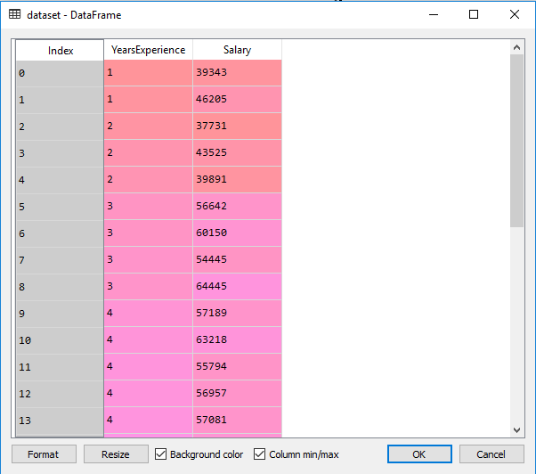
Change format to 0f

Slide 15
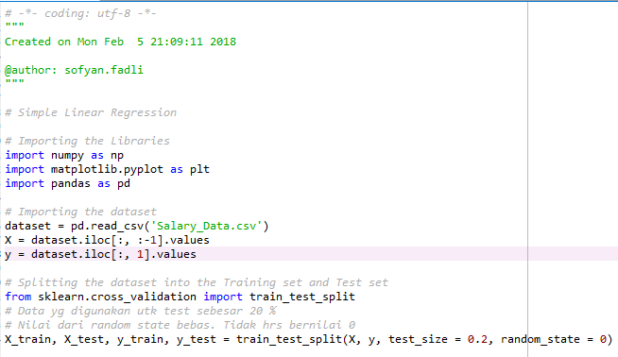
Ganti kedua nilai ini

Slide 16
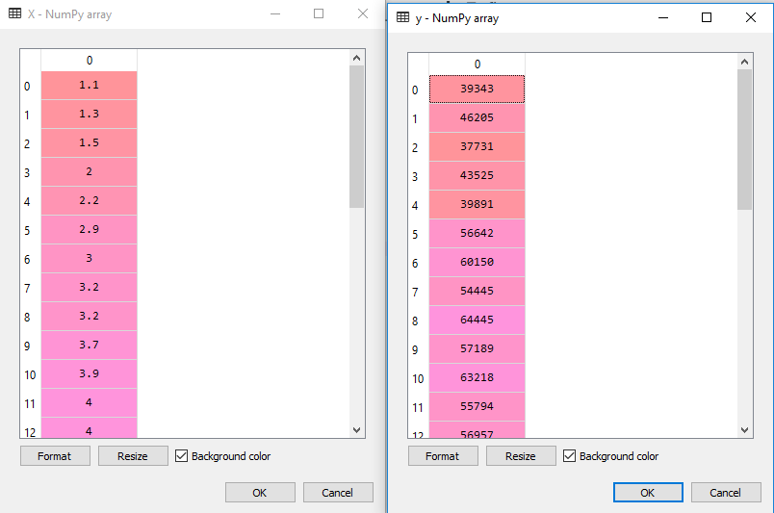

Slide 17
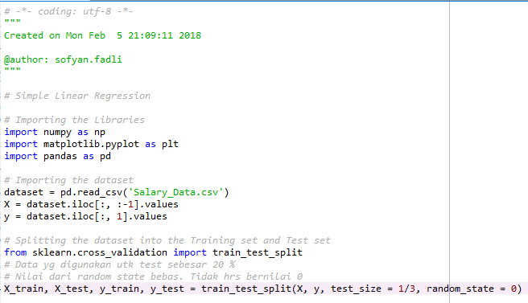
Ganti nilai ini

Slide 18
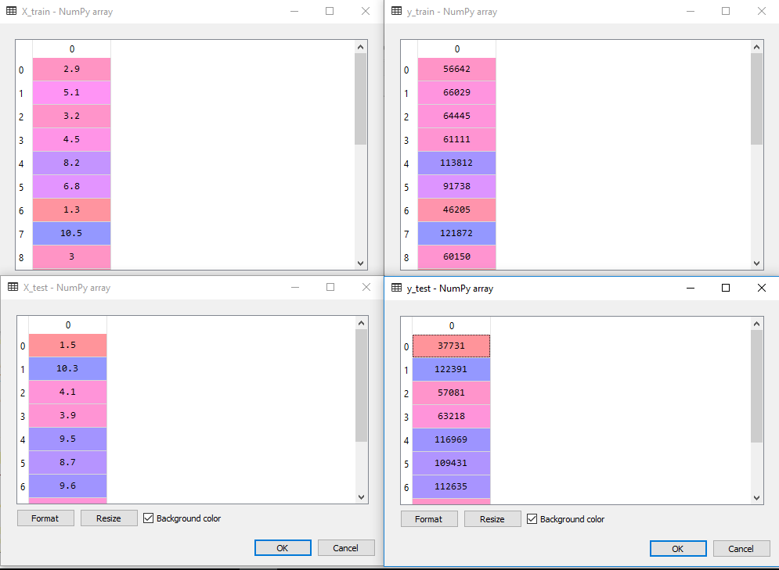

Slide 19
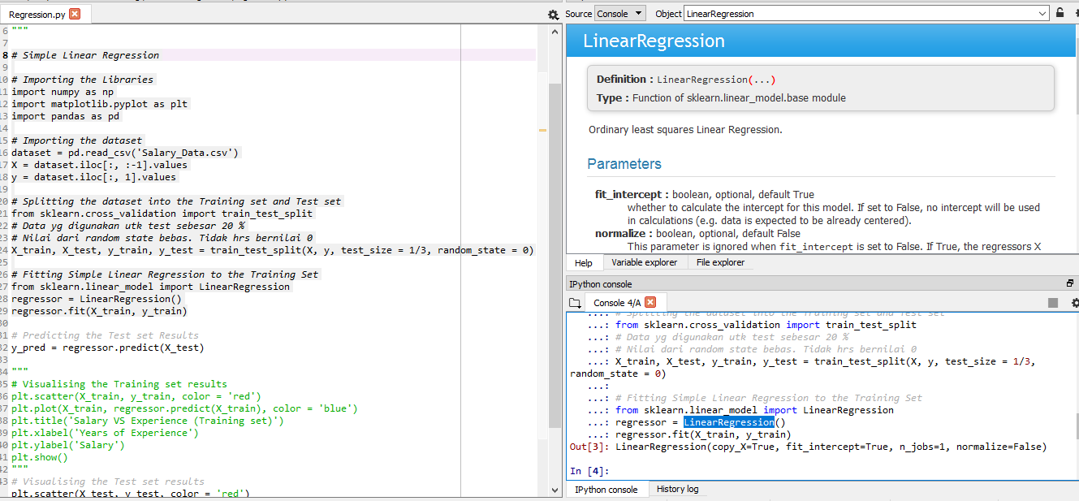

Slide 20
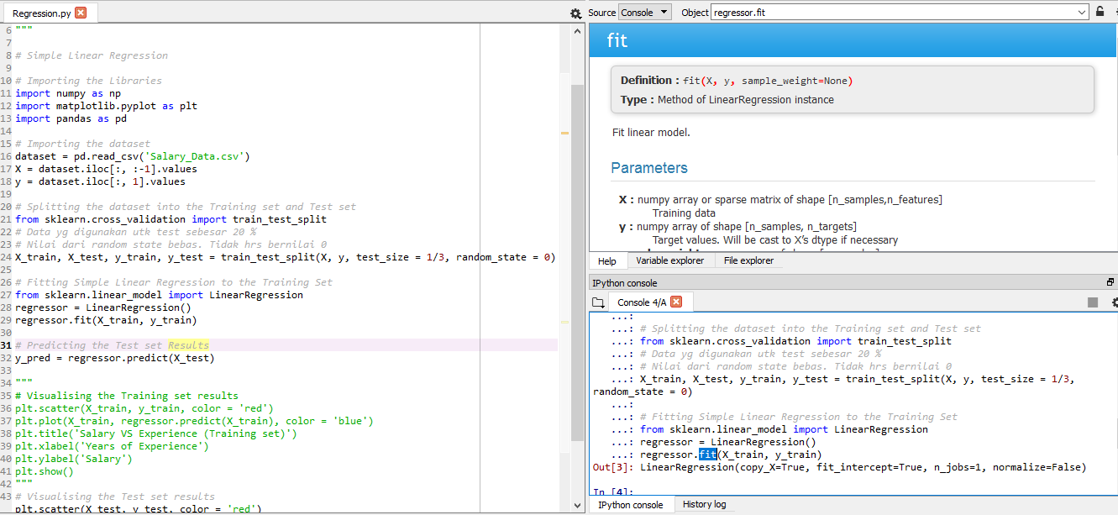
Press Ctrl + I

Slide 21
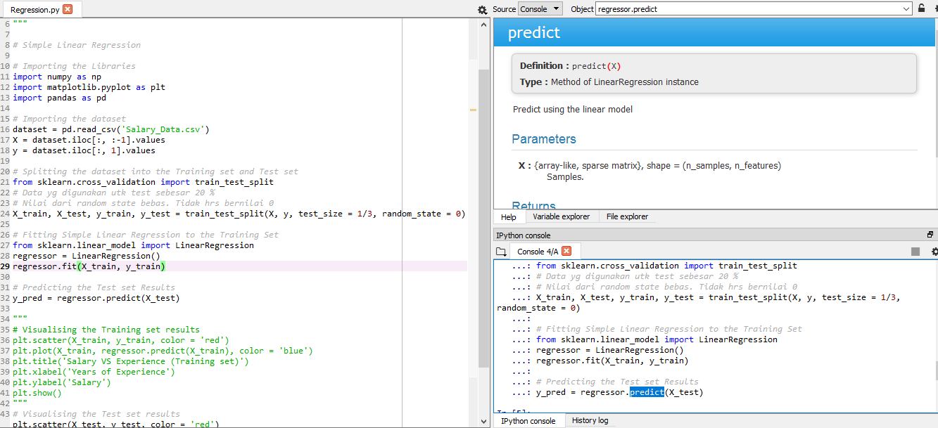

Slide 22
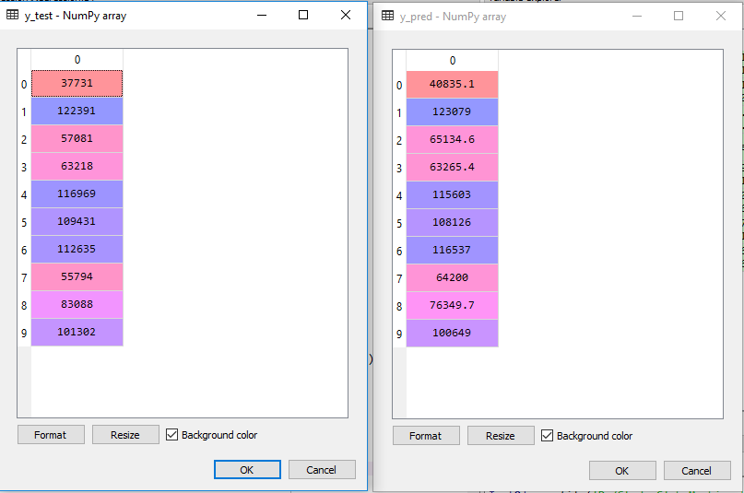
Nilai sebenarnya
Nilai Prediksi

Slide 23
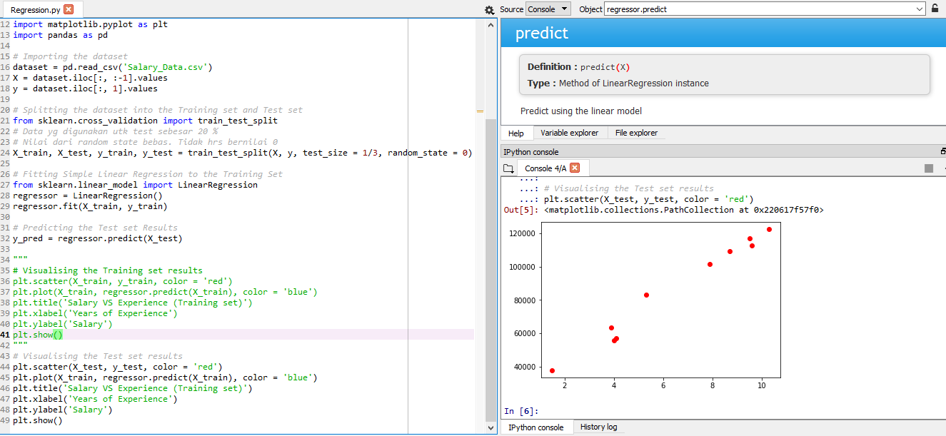

Slide 24
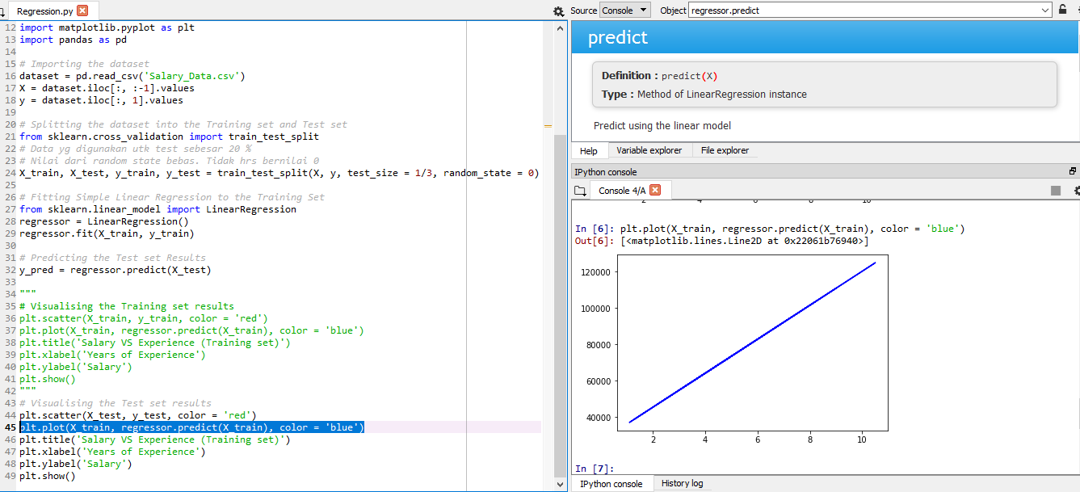

Slide 25
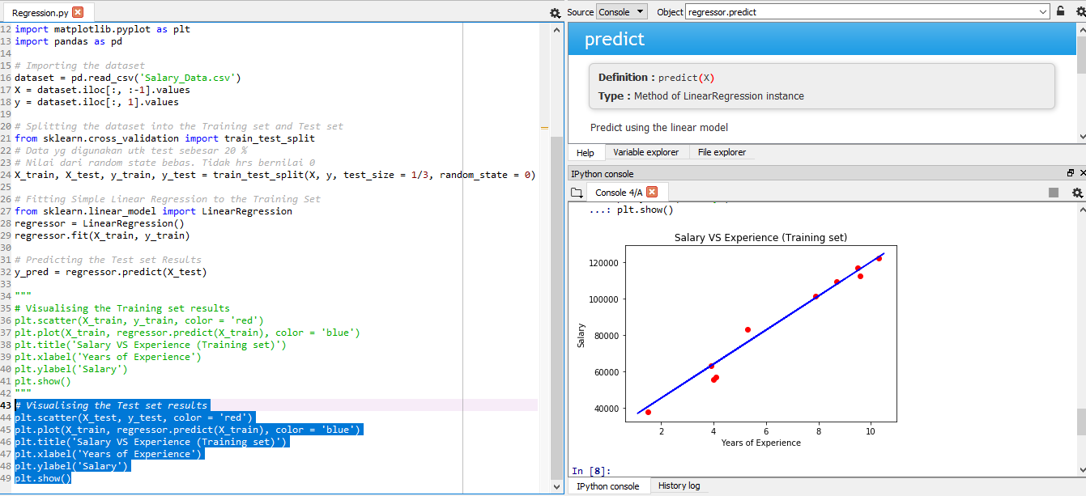

Slide 26
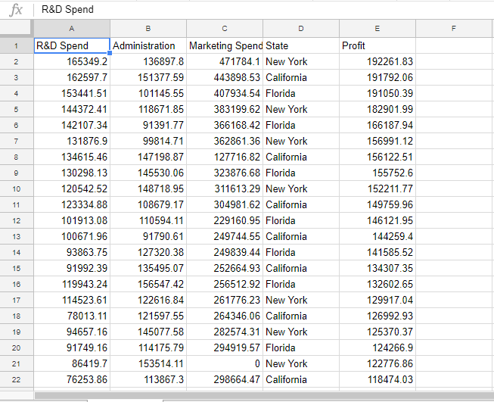

Problem 2 : Predict Profit of Start up Company

Slide 27
MULTIPLE LINEAR REGRESSION
PART II

Slide 28
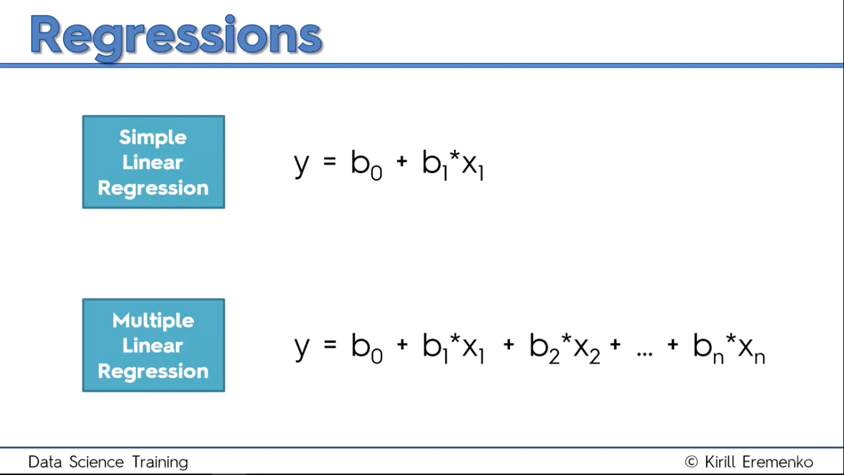

Slide 29
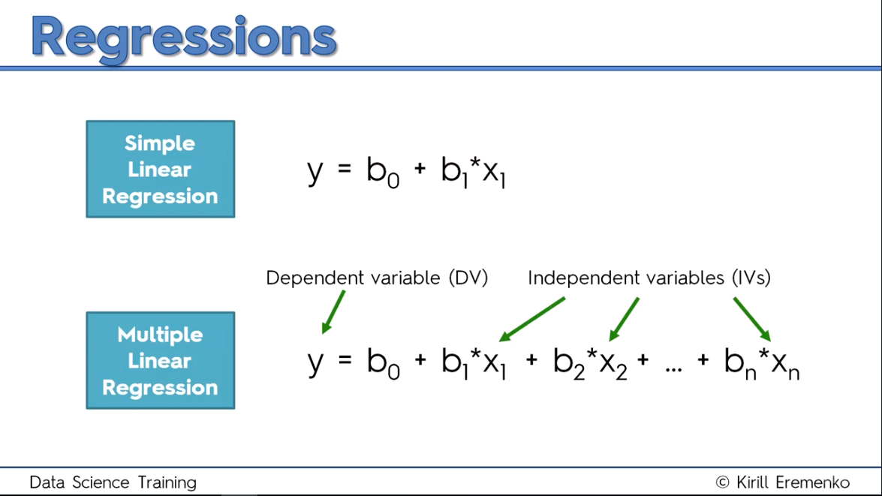

Slide 30
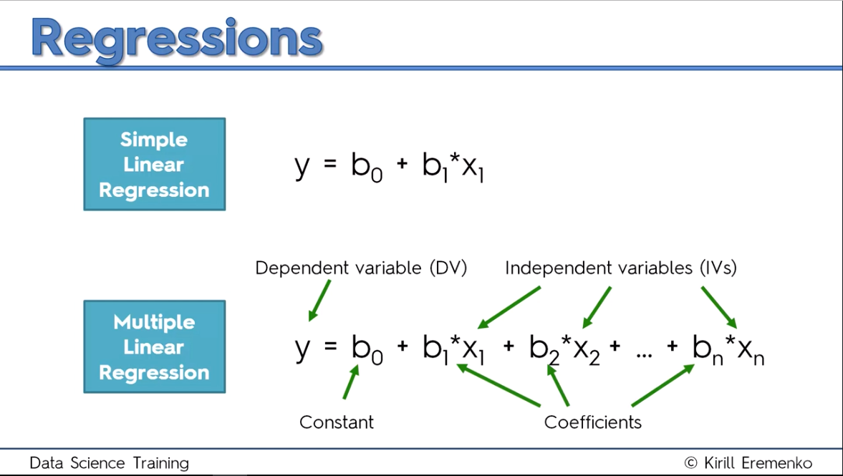

Slide 31
Assumptions of a Linear Regression:
1. Linearity
2. Homoscedasticity
3. Multivariate normality
4. Independence of errors
5. Lack of multicollinearity

Slide 32
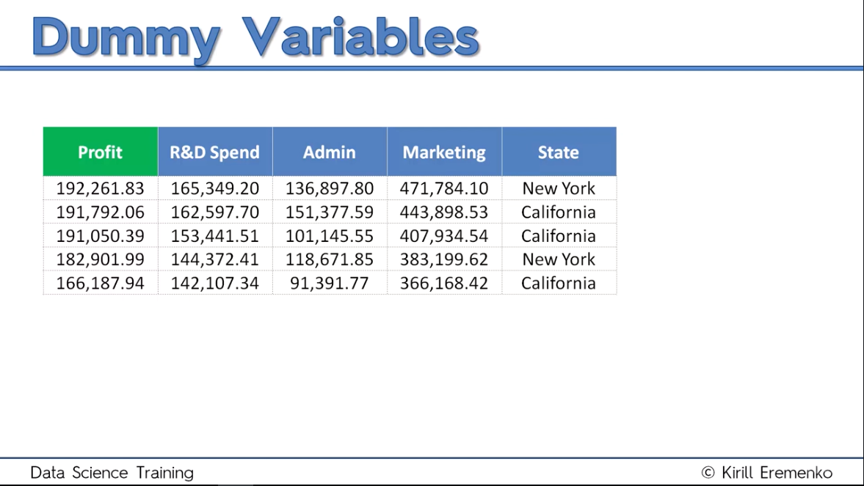

Slide 33
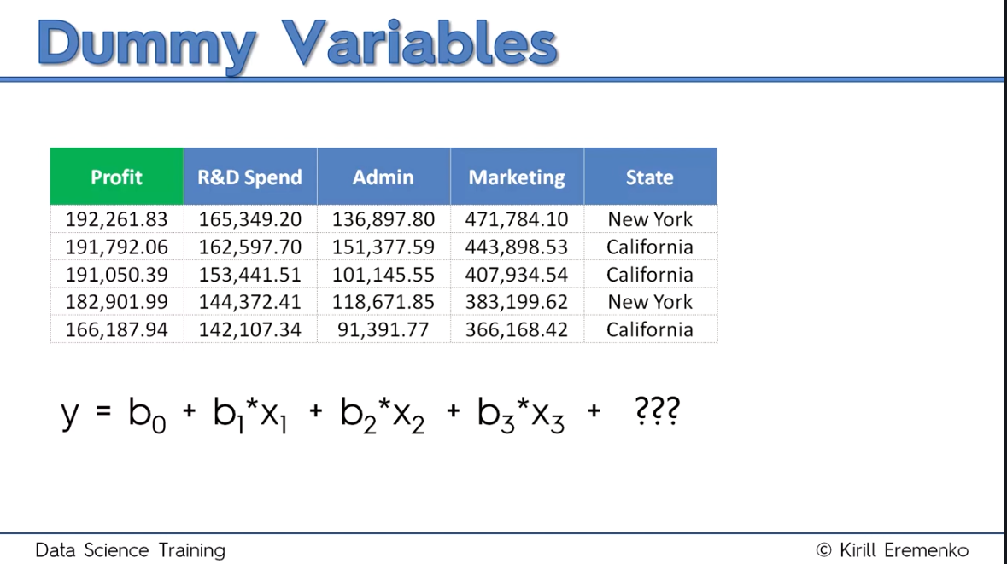

Slide 34
Numeric Variables
Categorical Variables

Slide 35
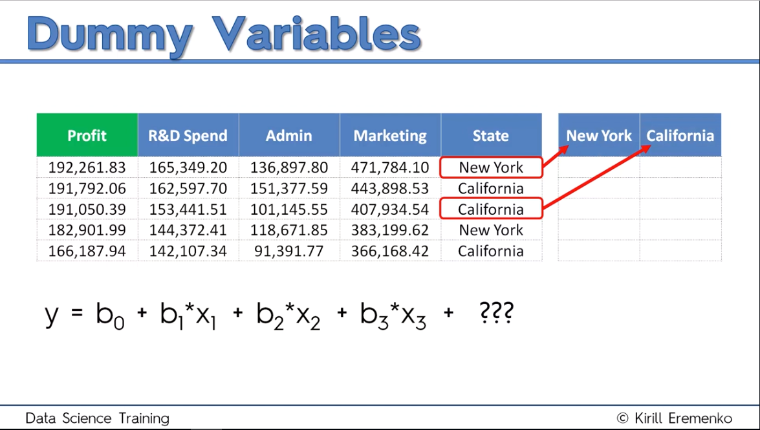

Slide 36
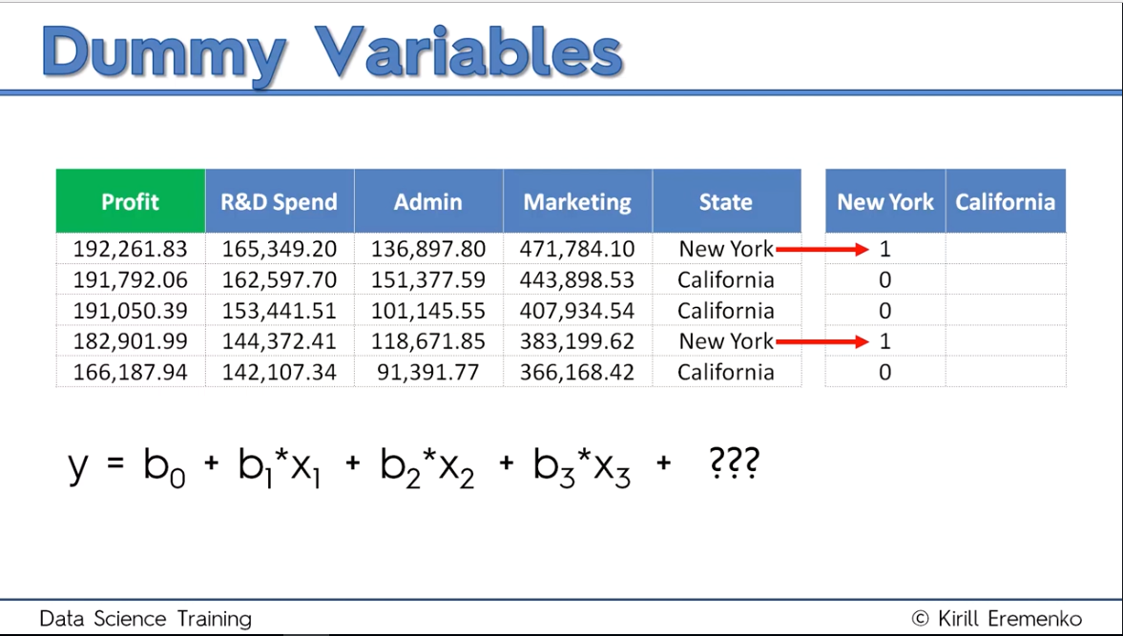

Slide 37
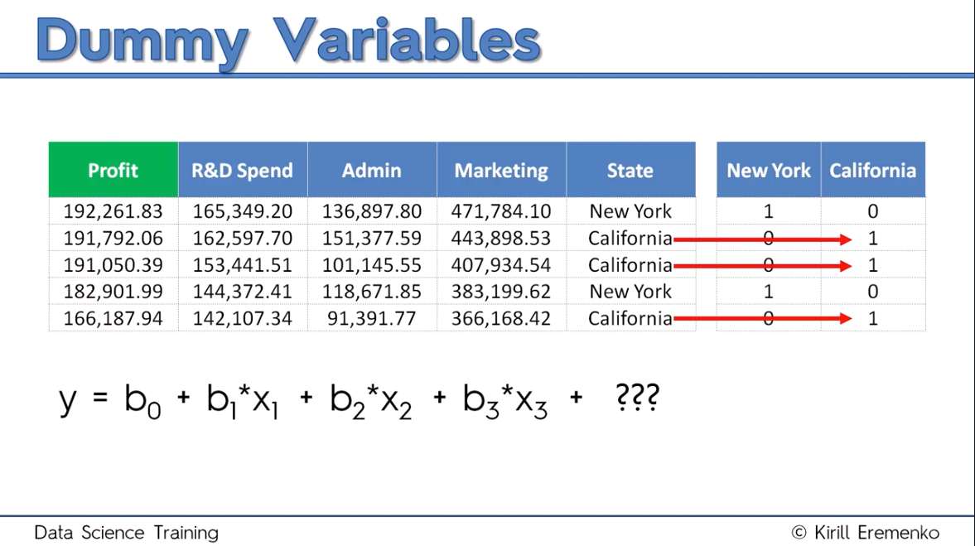

Slide 38
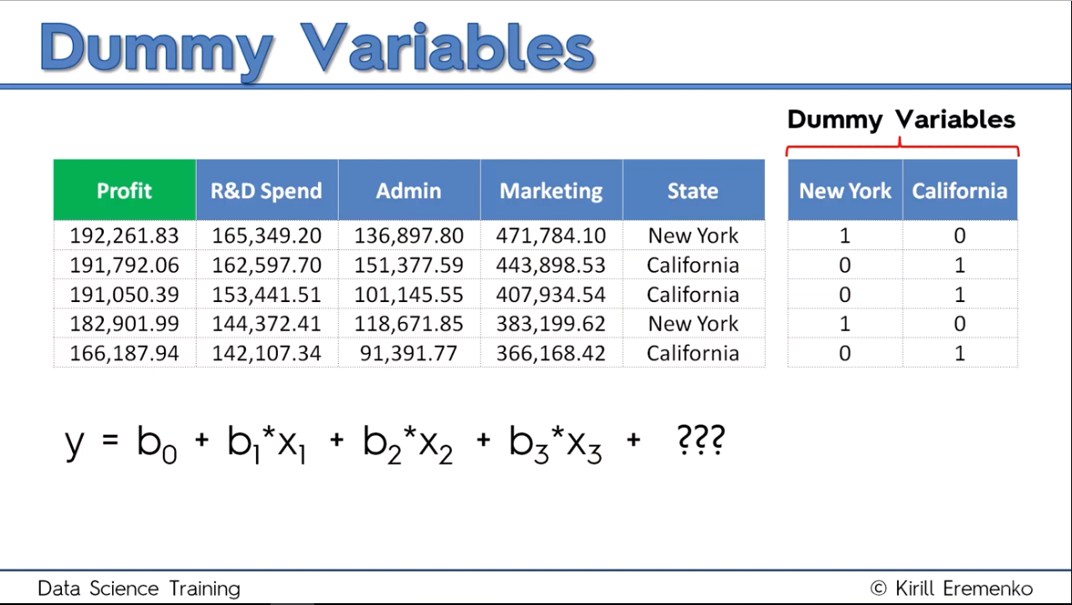

Slide 39
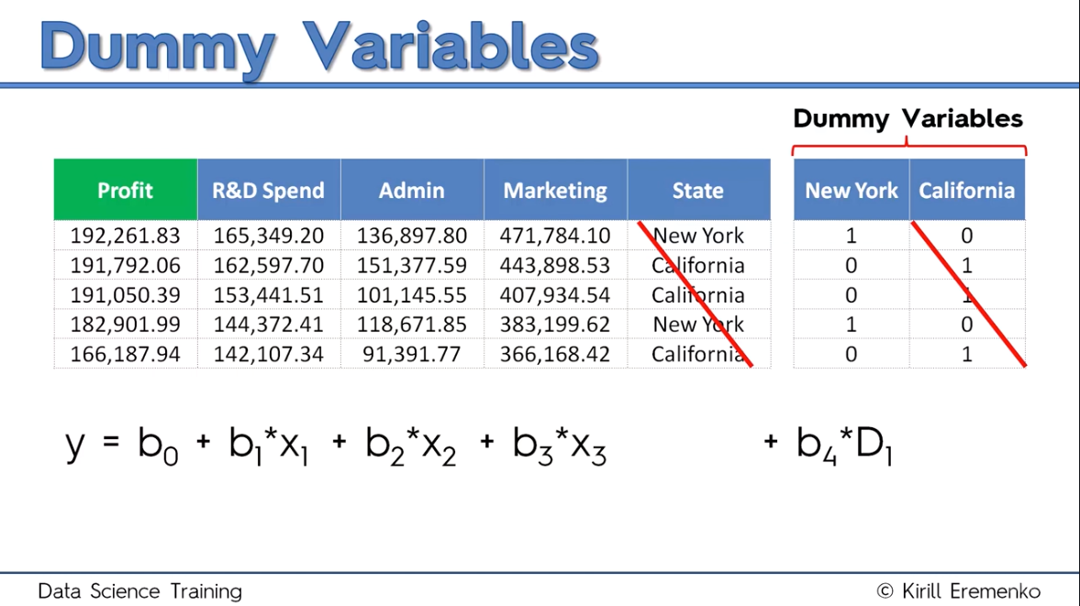

Slide 40
Seperti Switches

Slide 41
Terkesan
“Bias”

Slide 42
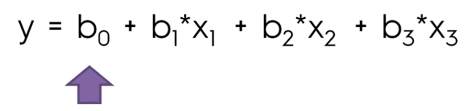
Kenyataannya tidak…
Regresion model akan menganggap variable dummy yang tidak kita masukkan ke dalam model akan dianggap sebagai kondisi default.

Slide 43
Dummy Variables Trap

Slide 44

Apa yang akan terjadi jika kita memasukkan semua dummy variable ke persamaan model machine learning ???
Kita akan terjebak dalam kondisi yang dinamakan dengan “dummy variable trap”

Slide 45
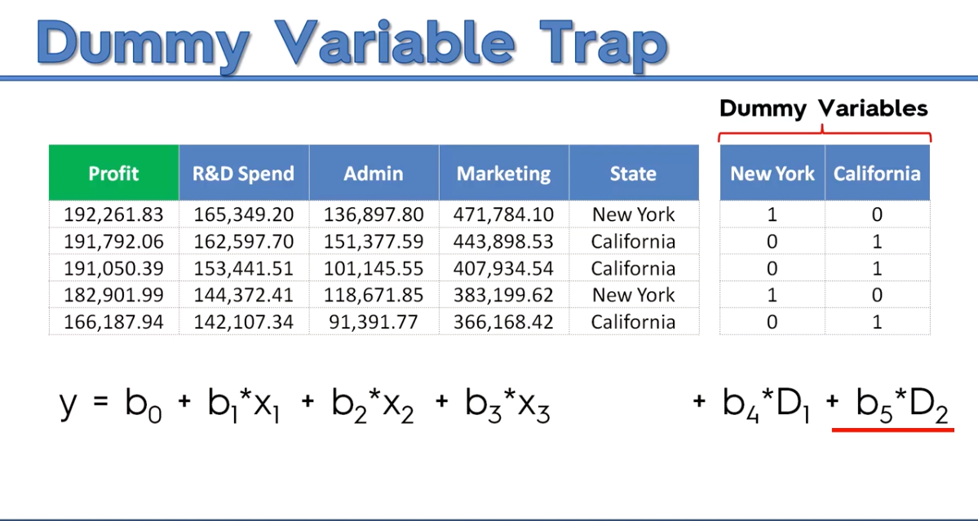

Slide 46
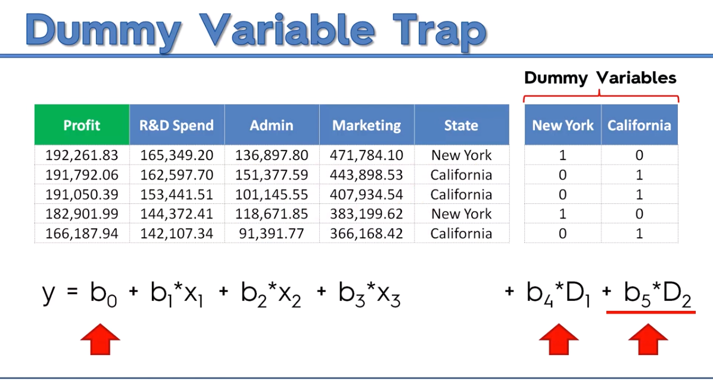
D2 = 1 – D1

Slide 47
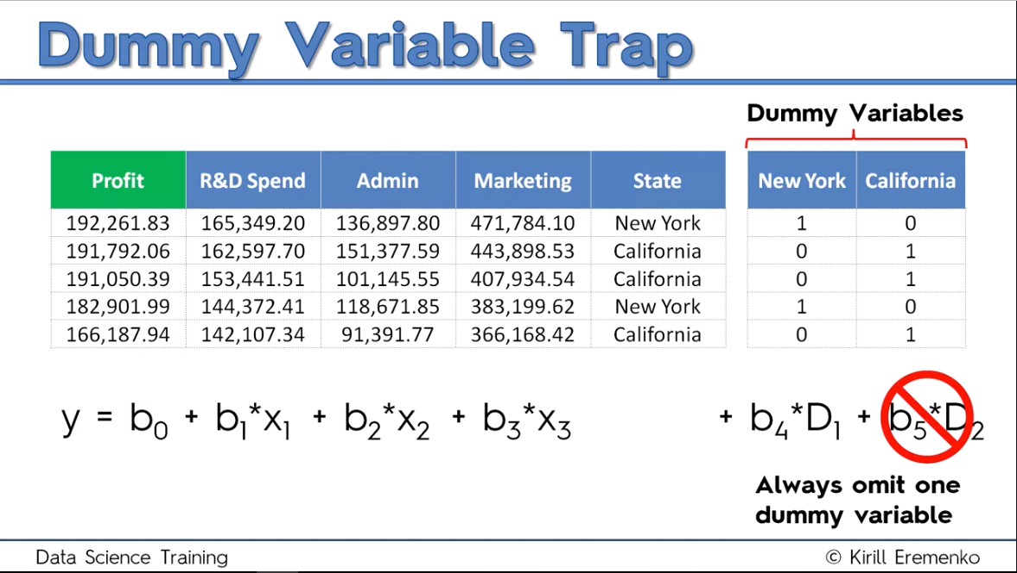
Kita tidak dapat memasukkan semua dummy variables ke dalam model ML !!!

Slide 48
What is P-Value???

Slide 49
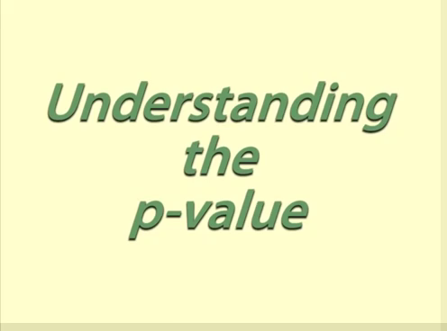

Slide 50

Break Time !!!

Slide 51
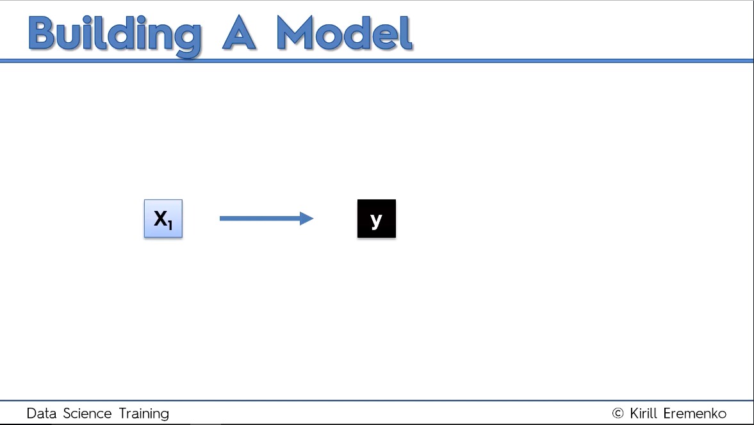

Slide 52
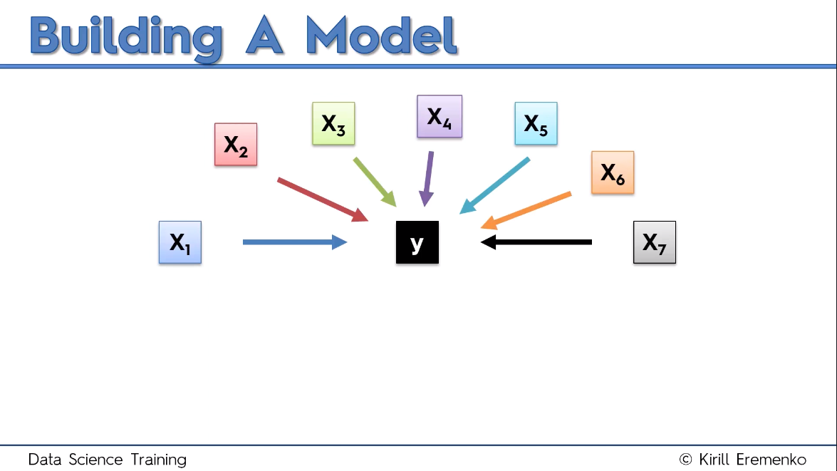

Slide 53
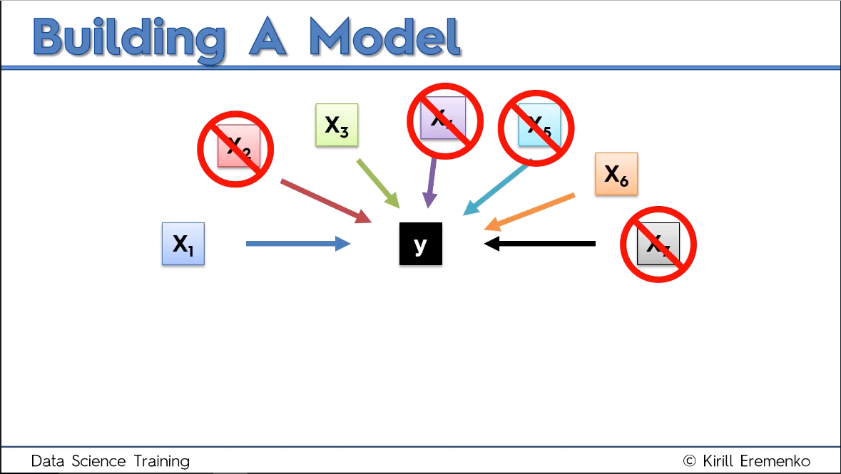
WHY ???

Slide 54
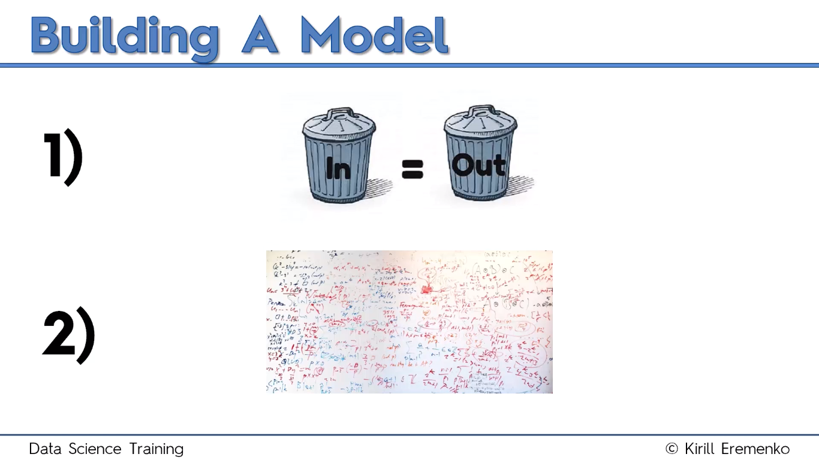

Slide 55
5 Methods for Building the Models:
1. All-in
2. Backward Elimination
3. Forward Selection
4. Bidirectional Elimination
5. Score Comparison

Slide 56
Building the Models:
1. All-in
2. Backward Elimination
3. Forward Selection
4. Bidirectional Elimination
5. Score Comparison
Stepwise
Regression

Slide 57

Building the Models
"All-in" - cases :
Prior knowledge
You have to
Preparing for Backward Elimination

Slide 58
Backward Elimination
Step 1: Select a significance level to stay in the model (example SL = 0.05)
Step 2: Fit the full model with all possible predictors
Step 3: Consider the predictor with the highest P-value. If P > SL, go to Step 4, otherwise go to FIN
Step 4: Remove predictor
Step 5: Fit model without this variable

Slide 59
Backward Elimination
Step 1: Select a significance level to stay in the model (example SL = 0.05)
Step 2: Fit the full model with all possible predictors
Step 3: Consider the predictor with the highest P-value. If P > SL, go to Step 4, otherwise go to FIN
Step 4: Remove predictor
Step 5: Fit model without this variable
Model telah selesai dibuat

Slide 60
Forward Selection
Step 1: Select a significance level to enter the model (e.g. SL = 0.05)
Step 2: Fit all simple regression models y ~ Xn Select the one with the lowest P-value
Step 3: Keep this variable and fit all possible models with one extra predictor added to the one's you already have
Step 4: Consider the predictor with the lowest P-value. If P < SL, go to STEP 3, otherwise go to FIN

Slide 61
Forward Selection
Step 1: Select a significance level to enter the model (e.g. SL = 0.05)
Step 2: Fit all simple regression models y ~ Xn Select the one with the lowest P-value
Step 3: Keep this variable and fit all possible models with one extra predictor added to the one's you already have
Step 4: Consider the predictor with the lowest P-value. If P < SL, go to STEP 3, otherwise go to FIN
Model telah selesai dibuat

Slide 62
Bidirectional Elimination
Step 1: Select a significance level to enter and to stay in the model
e.g.: SLENTER = 0.05, SLSTAY = 0.05
Step 2: Perform the next step of Forward Selection (new variables must have: P < SLENTER to enter)
Step 3: Perform All steps of Backward Elimination (old variables must have P < SLSTAY to stay)
Step 4: No new variables can enter and no old variables can exit

Slide 63
Bidirectional Elimination
Step 1: Select a significance level to enter and to stay in the model
e.g.: SLENTER = 0.05, SLSTAY = 0.05
Step 2: Perform the next step of Forward Selection (new variables must have: P < SLENTER to enter)
Step 3: Perform All steps of Backward Elimination (old variables must have P < SLSTAY to stay)
Step 4: No new variables can enter and no old variables can exit
Model telah selesai dibuat

Slide 64
All Possible Models
Step 1: Select a criterion of goodness of fit (e.g. Akaike criterion)
Step 2: Construct All Possible Regression Models: 2^N-1 total combinations
Step 3: Select the one with the best criterion
Step 4: Your model is Ready

Slide 65
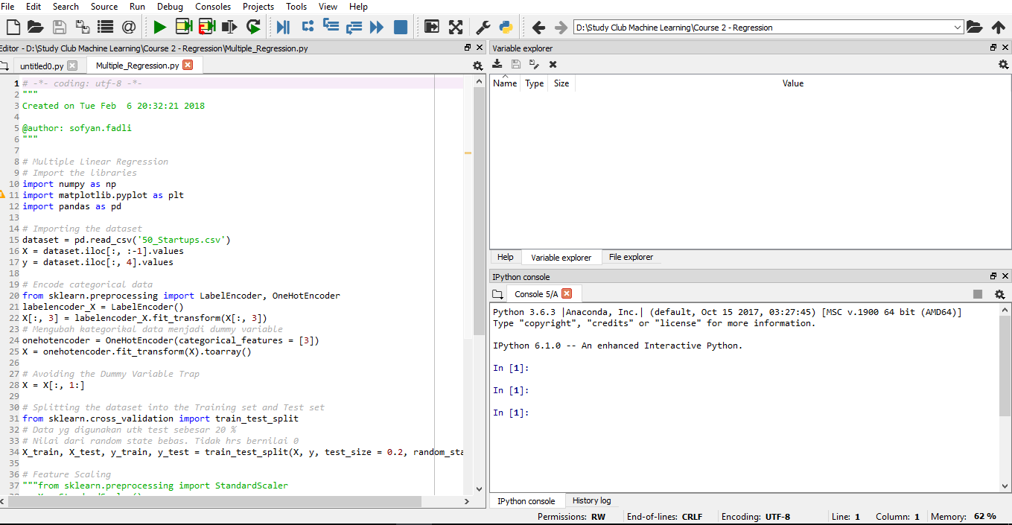
Set Working Directory terlebih dahulu
Ada di pojok kanan atas

Slide 66
Data Preprocessing Template

Slide 67
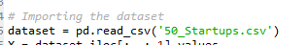
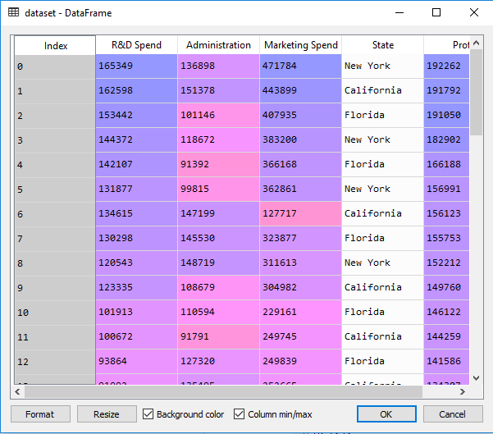

Slide 68
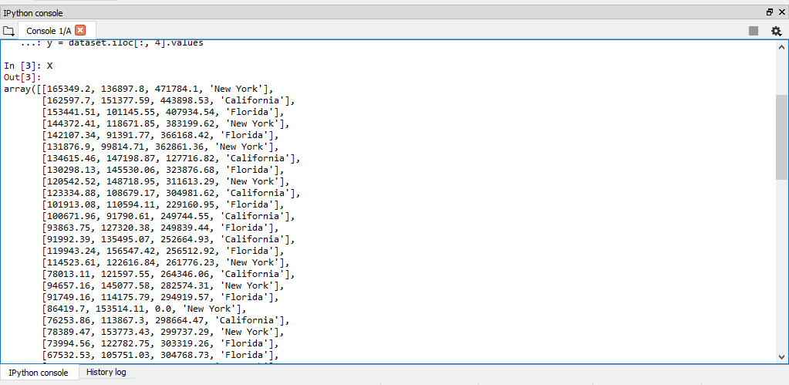
Kita harus meng-encode categorical variable

Slide 69
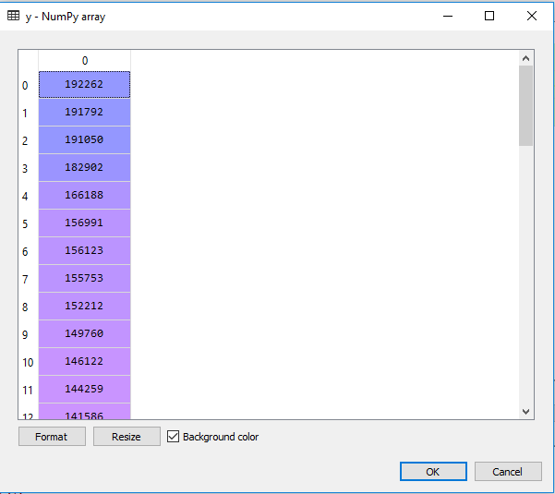

Slide 70
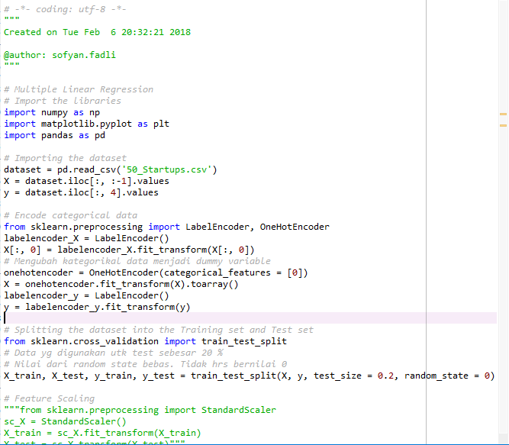
Template utk mengubah categorical variable ke dummy variable

Slide 71
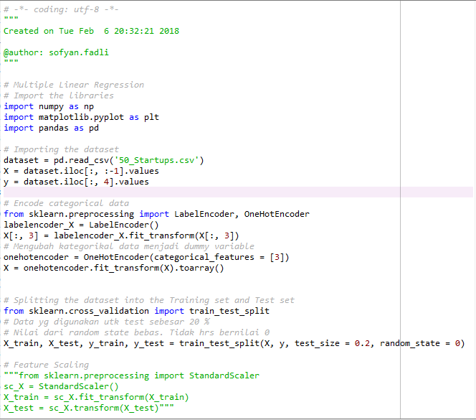

Slide 72
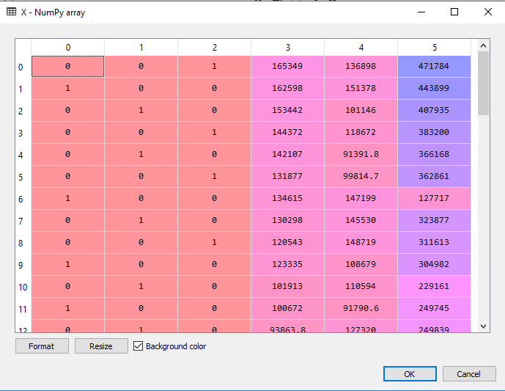
Dummy Variables

Slide 74
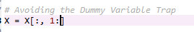
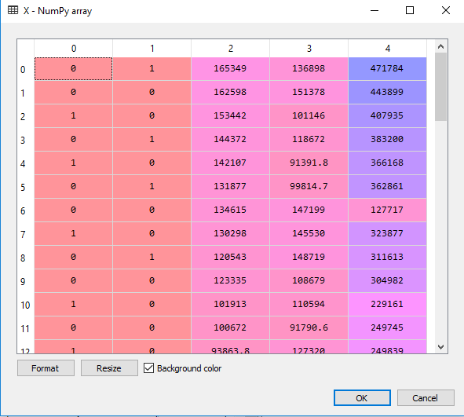
Satu kolom telah dihilangkan (kolom index 0)

Slide 75
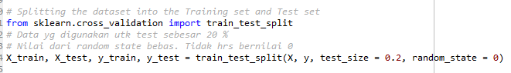
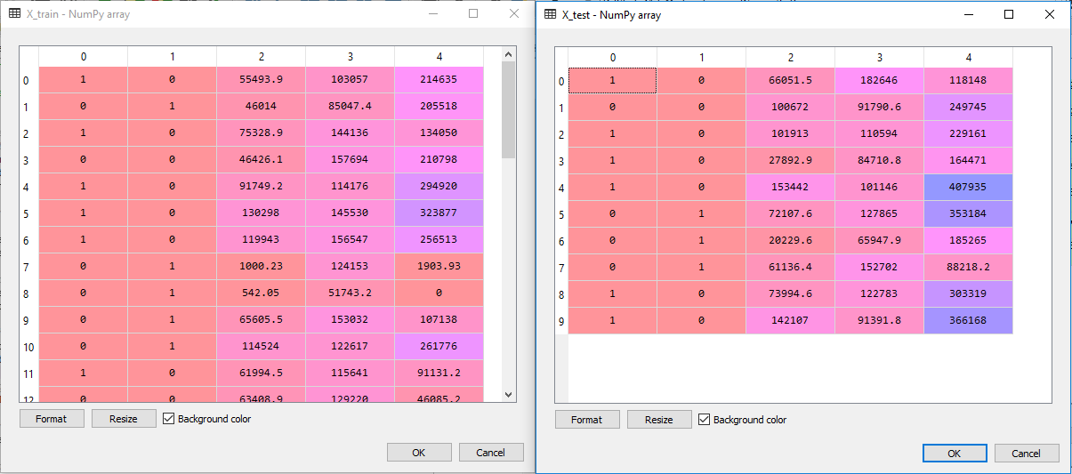
Membagi dataset menjadi train set dan test set

Slide 76


Slide 77

Object
Class

Slide 78



Slide 79
Backwards Elimination

Slide 80


Slide 81


Slide 82




Slide 83


Slide 84


Slide 85


Slide 86
Polynomial Linear Regression
PART III

Slide 87


Slide 88


Slide 89


Slide 90


Slide 91


Slide 92

One Question : Why “Linear” ???

Slide 93


Slide 94

Our Dataset

Slide 95

Data Preprocessing Template

Slide 96

Khusus utk kasus ini, kita tdk perlu membagi dataset menjadi train set dan test set

Slide 97

Tekan Ctrl + I

Slide 98


Slide 99

X Linear
X Polynomial

Slide 100


Slide 101


Slide 102


Slide 103


Slide 104


Slide 105


Slide 106
Advanced Method Regression
Support Vector Regression (SVR)
Decision Tree Regression
Random Forest Regression

